Slide 1
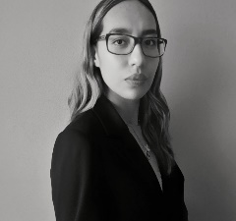
ARDC S&A
Poto
Luisa Gutiérrez
Trainee
Querétaro
EDUCATION
Bachelor's Degree, Applied Mathematics
Universidad Nacional Autónoma de México
ADMX AI Academy
Deloitte
EXPERTISE
Python - Project Experience
SQL - Project Experience
Microsoft Excel - Project Experience
Looker Studio - Training Only
PROFESSIONAL EXPERIENCE :
Luisa Gutierrez is trainee at the S&A portfolio where she is learning more about AI and Machine Learning. She has a degree in Applied Mathematics with solid background in Data Analyst and Data Science projects. She has technical skills in Python and SQL and holds the AZ-900 certification from Microsoft.
As part of her final projects at the University, Luisa developed and proposed solutions in the field of medicine. The first project dealt with the early detection of people at risk of dropping out of HIV treatment, and the second with the prediction of breast cancer using blood biomarkers in overweight or obese people. In both projects, she performed data processing, cleaning, imputation and visualization tasks, as well as proposing machine learning models. It should be noted that both projects were carried out independently by Luisa.
CLIENTS

